Slide 1
CAPSTONE ON FACIAL RECOGNITION
SUBMITTED BY,
Akshay s
Pgda-28

Slide 2
INTRODUCTION
Facial recognition is a technology that involves the automated identification or verification of individuals by analyzing and comparing their facial features to a database of known faces.
It uses algorithms to analyze and compare the unique features of a person's face, such as the distance between the eyes, the shape of the nose, and the contours of the jawline.
Facial recognition technology is commonly used for security and surveillance purposes, as well as for authentication and identification in various applications, including smartphones, payment systems, and social media platforms.

Slide 3
DESCRIPTION
The dataset being considered has different facial expressions of people when their picture is captured from different angles.
The folder in here is split into two : train and testing(validation), so that we can configure a model using this data.
The training set contains 200 images while the test set contains 50.

Slide 4
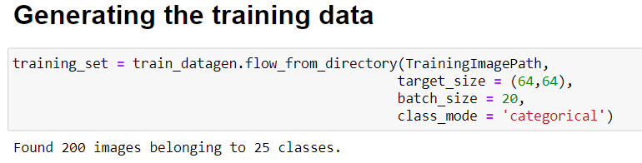
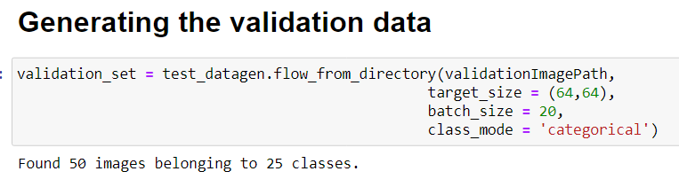
GENERATING TRAINING AND VALIDATION DATA

Slide 5



TRAINING SET

Slide 6



VALIDATION SET

Slide 7
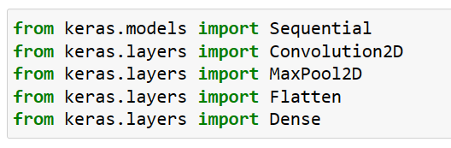
LIBRARIES USED
FOR CREATING CNN DEEP LEARNING MODEL

Slide 8

MODEL Preparation
Step 1- convolution:
STEP 2- MAX POOLING:

Slide 9
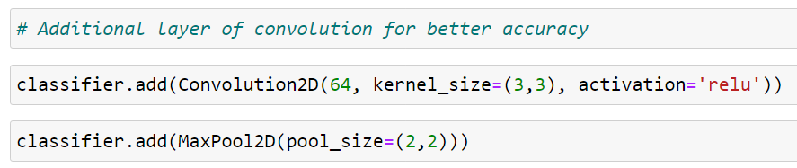

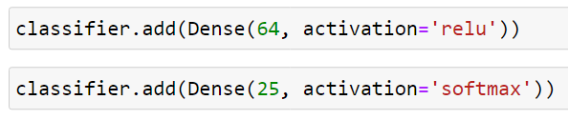
STEP 3- FLATTENING:
STEP 4-FULLY CONNECTED NEURAL NETWORK:

Slide 10
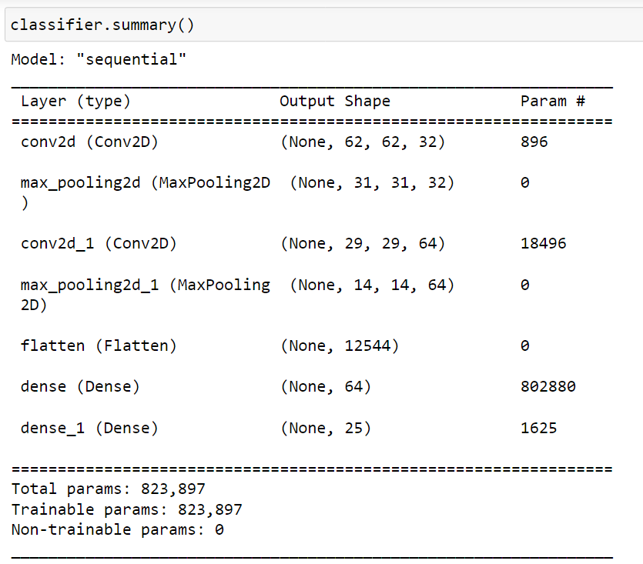
SUMMARY

Slide 11

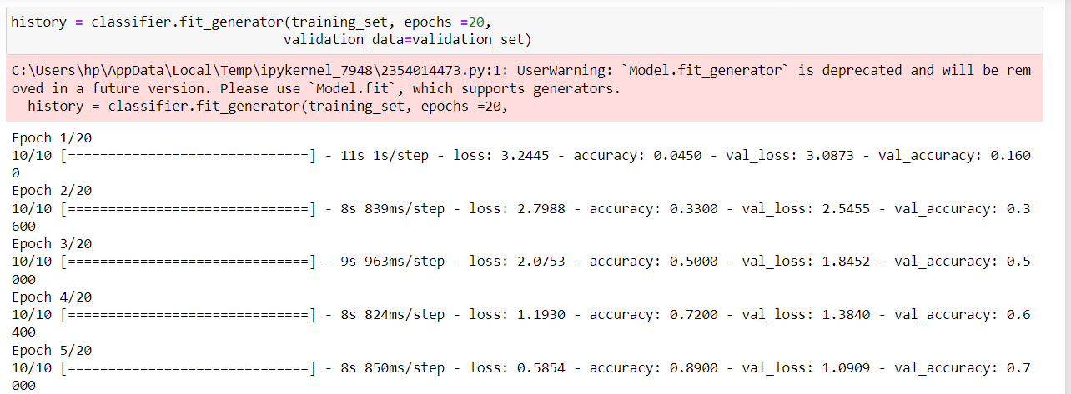
Compiler:
MODEL EXECUTION:

Slide 12
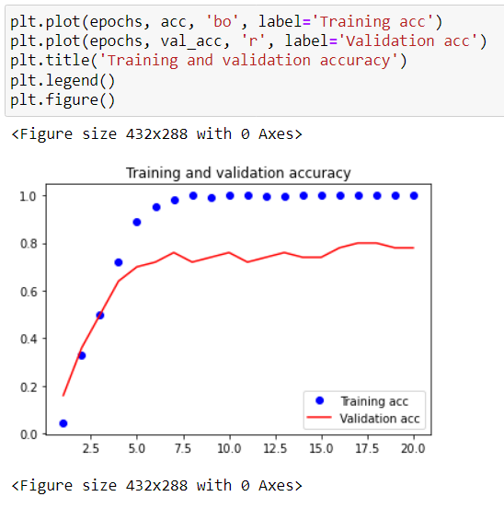
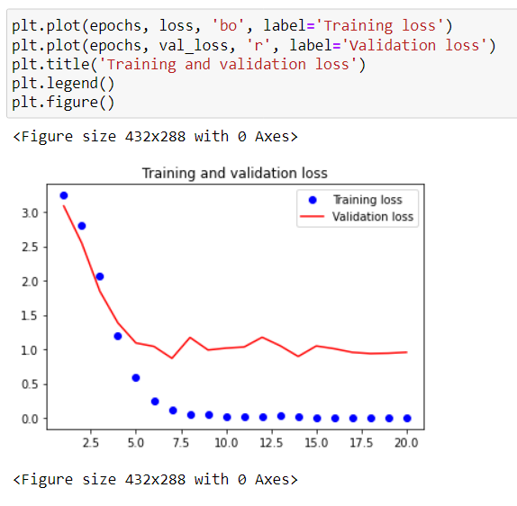
CURVES OF LOSS AND ACCURACY(TRAINING)
Accuracy base model
Loss base model

Slide 13
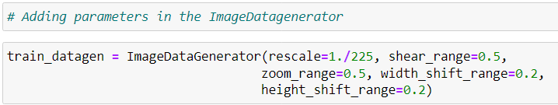
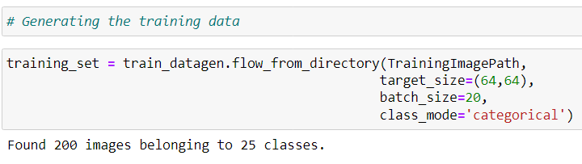
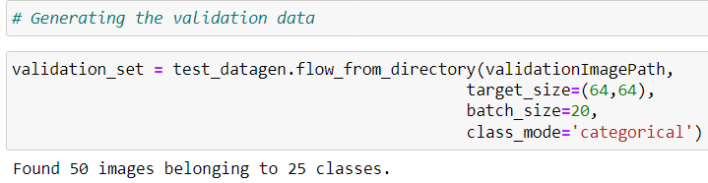
MODEL IMPROVEMENT

Slide 14
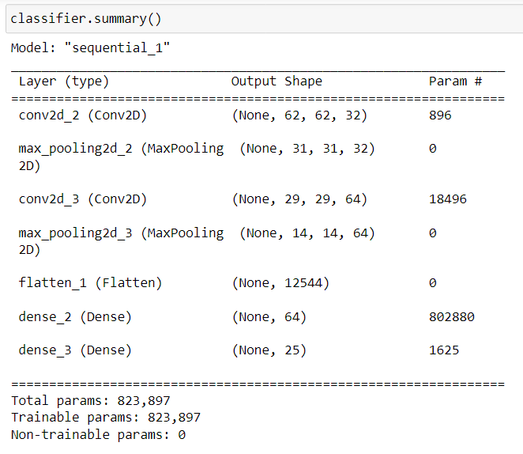
ABOVE MENTIONED STEPS FOR MODEL PREPARATION ARE REPEATED.
THE SUMMARY IS GENERATED AGAIN.

Slide 15

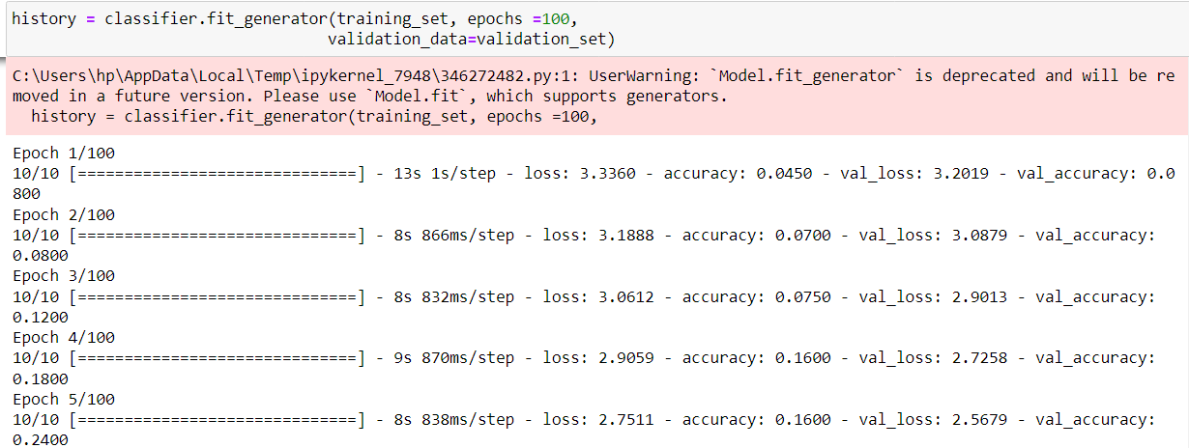
COMPILING AND EXECUTING

Slide 16
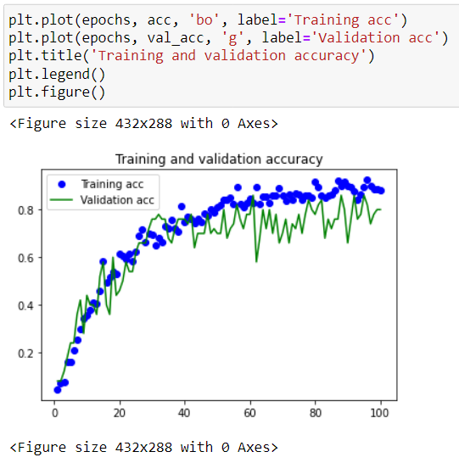
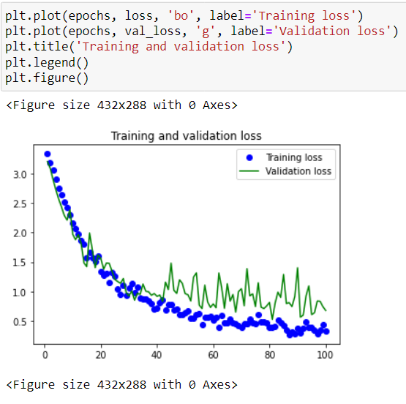
ACCURACY AND LOSS OF IMPROVISED MODEL
Accuracy of new model
Loss of new model

Slide 17
APPLICATIONS
Facial recognition systems have a wide range of potential uses across various industries and applications. Some of them are:
Security and law enforcement: facial recognition technology can be used for identifying suspects and criminals, monitoring public places for security threats, and improving border control and immigration processes.
Access control: facial recognition can be used for biometric authentication, such as unlocking smartphones, accessing bank accounts, or entering secured areas.
Marketing and advertising: facial recognition can be used for analyzing customer behavior and preferences, providing personalized product recommendations, and improving customer experiences.
Healthcare: facial recognition can be used for diagnosing genetic disorders, tracking disease progression, and identifying patients in medical settings.

Slide 18
conclusion
A facial recognition system is a technology capable of matching a human face from a digital image or a video frame against a database of faces. Such a system is typically employed to authenticate users through ID verification services, and works by pinpointing and measuring facial features from a given image.
It offers the ability to quickly and accurately verify or identify individuals based on their unique facial features.
Research shows that in the near future, facial recognition technology will make significant headway across industries. Businesses using facial recognition to target their marketing efforts toward their potential user base can benefit in more ways than one.

